Slide 1
Can AI Beat the Crowd?
UCLA · MIDTERM PROJECT · PROFESSOR CHENG
STATS C161 / C261
DATE & TIME
Oct 29, 2026
15 Min Presentation
“Is a prediction-market price a good probability, and can a model do better?”
Testing Market Efficiency, Favorite-Longshot Bias, and Wallet Micro-Behaviors on Polymarket
DATASET
WALLETS
VOLUME
7,479
55,952
4.1M
resolved markets on Polymarket
Tracked Profiles
trades used to read prices
By Leo Wong · Jiahong Chen · Aaron Wen
Lit · Market · Wallet
[Excused Note: Group consists of 3 undergraduate, 1 graduate dropped]
Notes:
LEO (about 40 seconds). Hi everyone, we are Leo, Jiahong and Aaron. Our project uses Polymarket, a prediction market where people trade shares that pay one dollar if an event happens. Our question is simple: is the price a good probability, and can an AI model do better than the crowd? Plan: first I will give a quick background from past research. Then Aaron tests whether prices are calibrated and whether models can beat them. Then Jiahong shows which wallets pay low prices. This matters because our final project looks for insider trading, and to spot an insider we first need to know how good the price already is.

Slide 2
EXECUTIVE OVERVIEW · LEO
SPEAKER: LEO (0:45)
The Story Arc: From Market Prices to Trader Intelligence
ACT I
ACT II
BRIDGING TO FINAL
Market Efficiency
Wallet Heterogeneity
Informed Detection
Prices on Polymarket are exceptionally well-calibrated out of sample. Predictive models cannot beat raw prices.
If the market is efficient overall, who buys low-probability longshots? Gradient boosting isolates key wallet traits.
Combining market anomalies with wallet profiling to detect informed/insider trading in Politics & Tech.
Notes:
"To structure today's presentation, we are presenting a connected narrative in three acts. First, Aaron analyzes the macro market to see if prices are well-calibrated and whether an AI model can beat them. Second, given Aaron's finding that the crowd is efficient overall, Jiahong dives into individual wallet data to ask who buys low-priced longshots and how wallet traits predict purchasing behavior. Finally, we bridge these two pillars into our roadmap for detecting informed or insider trading in our final report."

Slide 3
Academic Foundations: What past research says
BACKGROUND & PRIOR RESEARCH · LEO
SPEAKER: LEO (1:00)
Thaler and Ziemba (1988)
Snowberg and Wolfers (2010)
Journal of Economic Perspectives 2(2)
Journal of Political Economy 118(4)
“Surveys racetrack and lottery betting markets and the pricing anomalies found there.”
“Favorite-longshot bias: longshots are overbet and favorites underbet. Misperceived probabilities fit best.”
Wolfers and Zitzewitz (2004)
Page and Clemen (2013)
Journal of Economic Perspectives 18(2)
Economic Journal 123(568)
“Prediction-market forecasts are typically fairly accurate and beat many simple benchmarks.”
“Prices are reasonably calibrated close to expiry, but biased for events farther away.”
Our test: do these findings hold on Polymarket in 2026, from 7 days down to 6 hours before close?
Leo · Sources verified: JEP 2(2):161-174; JPE 118(4):723-746; JEP 18(2):107-126; Economic Journal 123(568):491-513
Notes:
LEO (about 50 seconds). Four papers frame our work. Thaler and Ziemba surveyed racetrack and lottery betting and the odd pricing patterns there. Snowberg and Wolfers describe the favorite-longshot bias: long shots get bet too much and favorites too little. Wolfers and Zitzewitz survey prediction markets and conclude their forecasts are typically fairly accurate. Page and Clemen ask exactly our question, whether prediction market prices are well calibrated, and find yes near expiry but bias for events farther out. So the open question for us is whether Polymarket in 2026 behaves the same way. Aaron will answer that. (We checked each citation: volume, issue and pages are correct.)

Slide 4
A price is a probability
SPEAKER: AARON (0:45)
MARKET · AARON
E[profit] = p − c
1 · Is the price calibrated?
Does 30% happen 30% of the time?
p is your belief, c is the share price. Buy while p > c, sell while p < c, so the price settles near the crowd’s belief.
2 · Can a model beat it?
Using only information known at the time.
Classic finding from betting markets: the favorite-longshot bias, where long shots are overpriced. We test whether it shows up here.
Market part · Slide 1 of 7
Notes:
AARON. Our question is simple: is the market's price a good probability, and can a model do better? On Polymarket a Yes share pays one dollar if the event happens. If you think the chance is p and the share costs c, your expected profit is p minus c. So people buy until the price matches what the crowd believes, which makes the price a forecast we can grade. A classic finding from betting markets is the favorite-longshot bias: long shots are overpriced. We test whether that shows up here.

Slide 5
Data Methodology & Pipeline
MARKET · AARON
SPEAKER: AARON (1:00)
Resolved markets
Price before close
Grade against outcome
7,479 Yes/No markets, Politics, Technology, Entertainment and Economy, closing Jun to Oct 2026. Categories from Polymarket event tags.
→
4.1M trades. We read the last trade before 6 hours, 24 hours, 3 days and 7 days to close.
→
Brier score and calibration curves, with confidence intervals that resample whole events.
Order book recorded only about 22% of these markets. Where both exist, trade price and book midpoint agree: correlation 0.92, median gap 0.9 cents.
7,479
4.1M
4
0.92
Resolved Markets
Trade Records
Horizons (6h, 24h, 3d, 7d)
Order-Book Correlation
Rigorous Validation Framework
Median Gap: 0.9¢
Brier score metrics evaluated using event-level block bootstrap confidence intervals.
Market part · Slide 2 of 7
Notes:
AARON. We took every Yes/No market in our four categories that resolved from June to October, and read its price at four points before it closed. The course database has no category field, so we used Polymarket's own event tags: politics, tech, pop culture and economy. That gives 7,479 markets. We first tried the hourly order book, but it only recorded about a fifth of these markets, so we used the last trade before each point, from 4.1 million trades. Where both sources exist they agree closely: correlation 0.92, median gap under one cent.

Slide 6
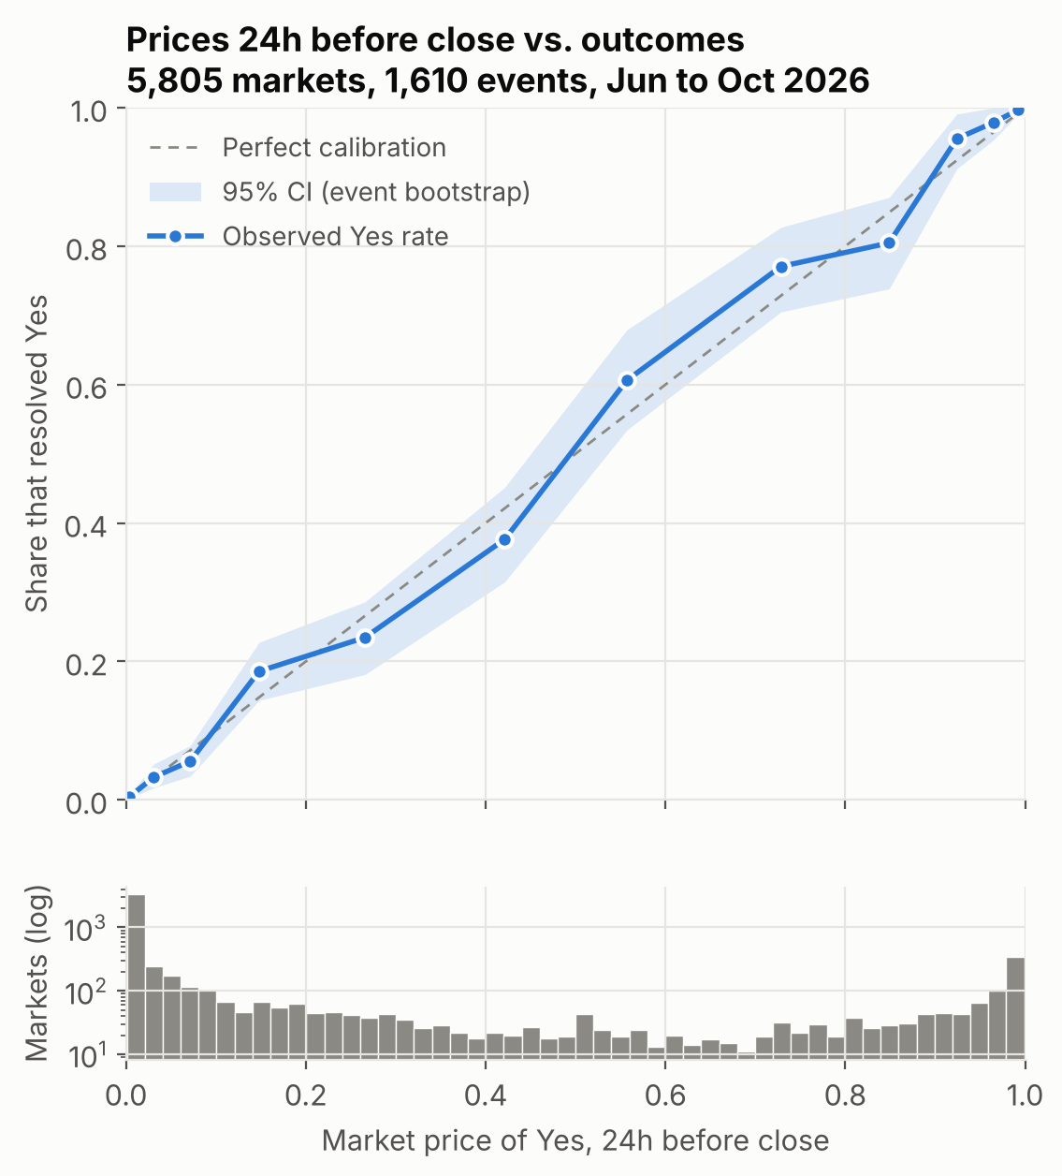
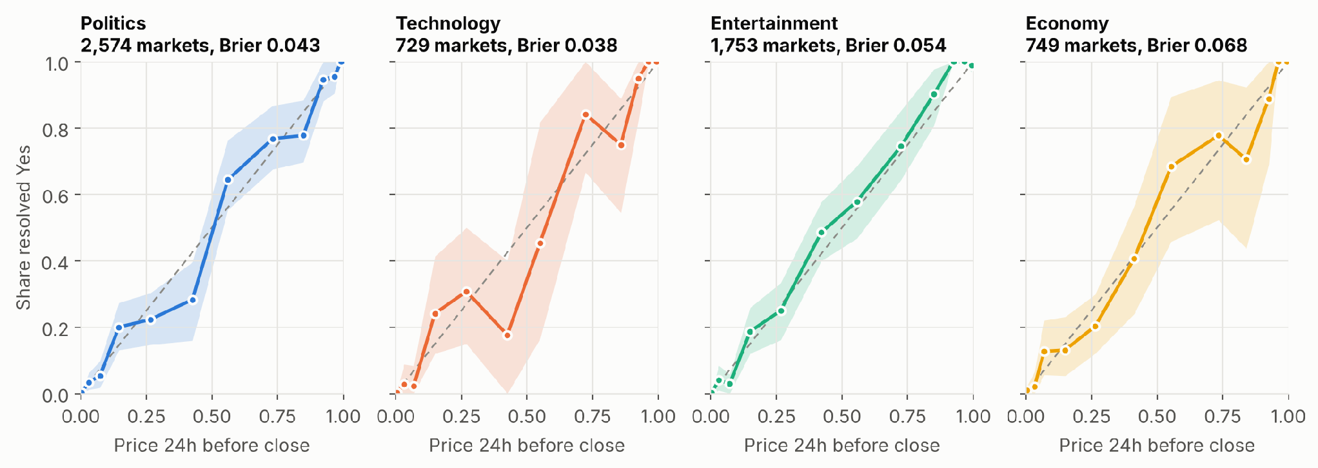
Calibration: the crowd is well calibrated
MARKET · AARON
CORE FINDING
Near-Perfect Alignment Across Topics
When the market says 30%, it happens about 30% of the time. The same holds in each category.
Market part · Slide 3 of 7 · About 1:00 · 5,805 markets, 24h before close
Notes:
AARON. When the market says 30 percent, it happens about 30 percent of the time. Each dot groups markets by their price a day before close and shows the share that actually resolved Yes. Perfect calibration is the diagonal, and the dots sit on it. The shaded band is a 95 percent interval. We resample whole events to build it, because markets in one event are linked: only one film can win Best Picture. Treating them as independent would make the band far too narrow. The same picture holds in all four categories (second figure).

Slide 7
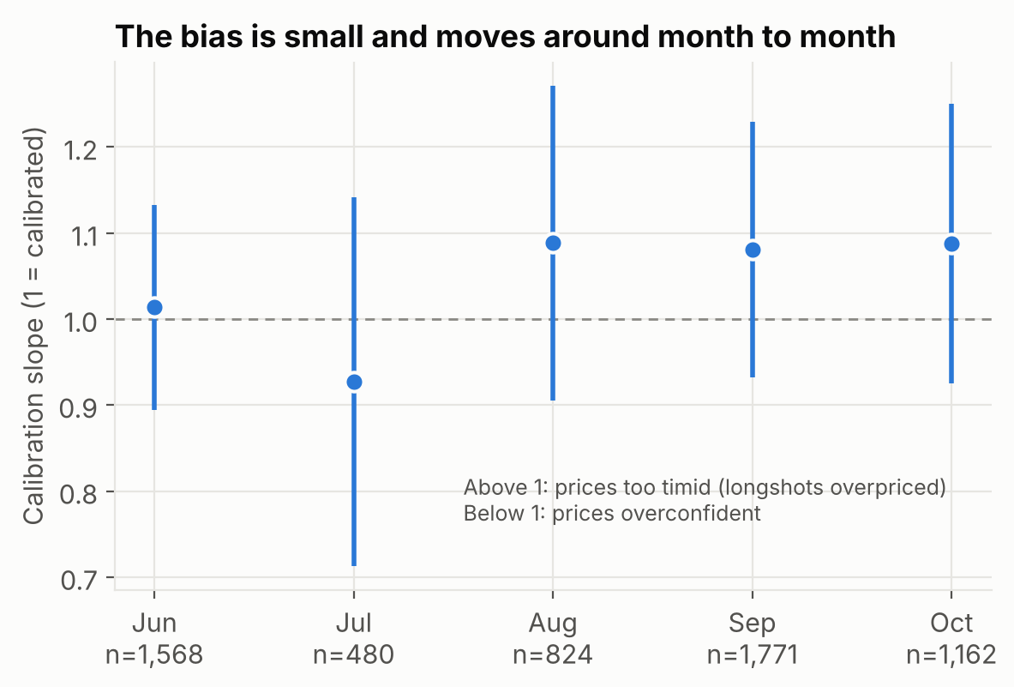
Favorite-longshot bias
MARKET · AARON
1.08
Raw Calibration Slope
calibration slope at 6h, all prices (95% CI 1.01 to 1.16)
1.00 Trimmed Slope (<2¢ / >98¢)
slope when prices under 2¢ and over 98¢ are dropped
0.93 to 1.09
Monthly Slope Range
monthly slope at 24h; every interval crosses 1
Market part · Slide 4 of 7 · About 1:15
Notes:
AARON. We find a faint trace of the bias, but it is not stable enough to matter. We summarize calibration with one number: regress the outcome on the log-odds of the price. A slope of 1 is perfect; above 1 means prices are too timid, so long shots are overpriced. Six hours before close the slope is 1.08, and its interval just excludes 1. But it comes entirely from prices under 2 cents or over 98 cents: drop those and the slope is 1.00. And month by month it moves between 0.93 and 1.09, with every interval crossing 1. So it is a weak effect that changes direction.

Slide 8
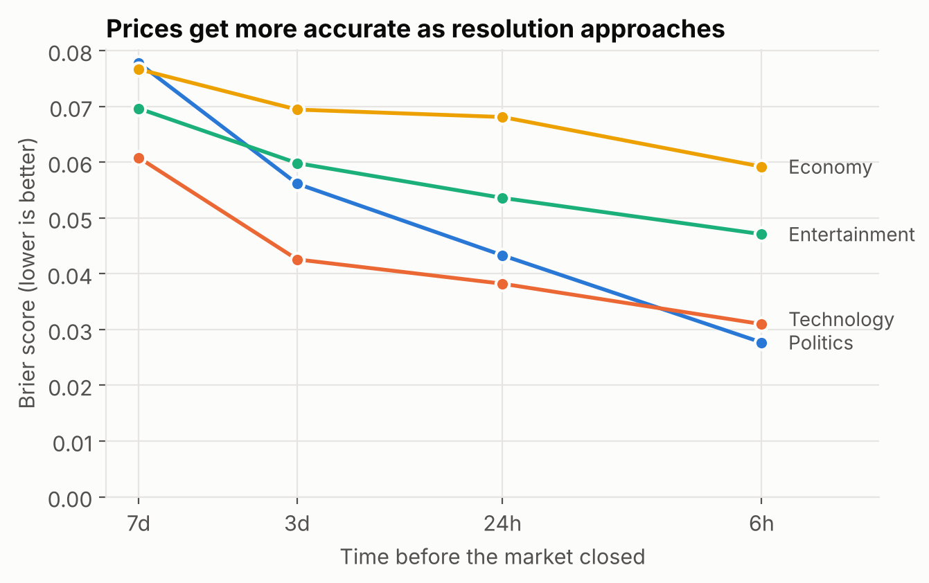
Accuracy over time and by category
MARKET · AARON
0.074 → 0.038
Brier score, all markets, 7 days to 6 hours before close
Politics improves the most. From 3 days out to the close, Economy is the hardest category to call.
Brier = average squared gap between price and outcome. Lower is better.
Politics: Fastest Convergence
Public polling data accelerates price discovery ahead of deadlines.
Economy: Highest Residual Error
Macro metrics maintain high variance right up to official releases.
Market part · Slide 5 of 7 · About 0:45
Notes:
AARON. Prices get sharper as the event gets closer, and economic questions stay the hardest. The Brier score is the average squared gap between the price and what happened, so lower is better. Across all markets it roughly halves from a week out to six hours out, from 0.074 to 0.038. Politics improves the most. From three days out to the close, Economy is the hardest category to call. (If we run long, say only the first two sentences.)

Slide 9
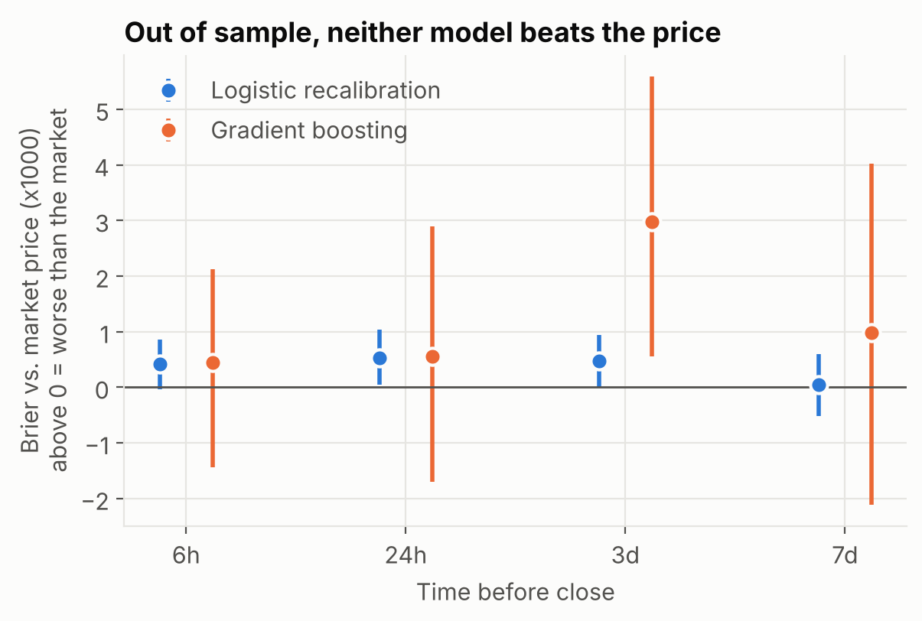
Can a model beat the price?
MARKET · AARON
Test Brier at 24h
Above zero in the chart = worse than the market.
Raw Market Price
0.0513
Baseline Benchmark
Logistic Recalibration
0.0518
+18 Features
Gradient Boosting (LightGBM)
0.0518
Full Book & Volume Features
Core Takeaway: No Overperformance
Trained on pre-Sept data and evaluated out-of-sample on 860 Sept–Oct events, machine learning models failed to outperform simple market prices.
Tree Weight on Price Feature: >95%
Market part · Slide 6 of 7 · About 1:15
Notes:
AARON. We tried to beat the crowd with two models, and neither did. We trained on events that finished before September and tested on September and October. No event sits on both sides, and every feature uses only trades before the time point, so nothing leaks. Model one re-calibrates the price, letting the correction differ by category and horizon. Model two is gradient boosting with the price plus 18 features known at the time: recent price moves, order flow, volume, number of traders, market age, time to the deadline, category. Both come out no better than the raw price, and the re-calibration is slightly worse. When we shuffle each feature, almost all the weight is on the price itself. That fits the previous slide: a bias that changes direction cannot be learned in summer and used in autumn.

Slide 10
Takeaways and limits
MARKET · AARON
1
2
3
Prices are well calibrated in all four categories.
The favorite-longshot bias is faint and unstable.
No model we built beats the price.
Limit: some markets close early because the event happened, so “24h before close” differs for Yes and No markets.
Limit: one test period, September to October 2026.
Conceptual Pivot to Act II
"Because prices are aggregate-efficient and un-scalable by standard ML models, an informed trader is not simply someone who wins a bet, but someone who systematically beats the prevailing market price."
NEXT STEP:
Analyze wallet-level heterogeneity to isolate informed trading patterns.
Market part · Slide 7 of 7 · About 1:00
Notes:
AARON. The market as a whole is hard to beat, and that gives us a clean definition for the final. Three takeaways: prices are well calibrated in all four categories; the favorite-longshot bias is faint and unstable; and no model we built beats the price. Two limits: some markets close early because the event happened, so 24 hours before close means slightly different things for Yes and No markets; and we have one test period. For the final: an insider is not someone who wins a lot, since buying at 95 cents wins a lot too. It is someone whose bets keep beating the price they paid. Jiahong will now show which wallets pay low prices, in other words who buys the long shots.

Slide 11
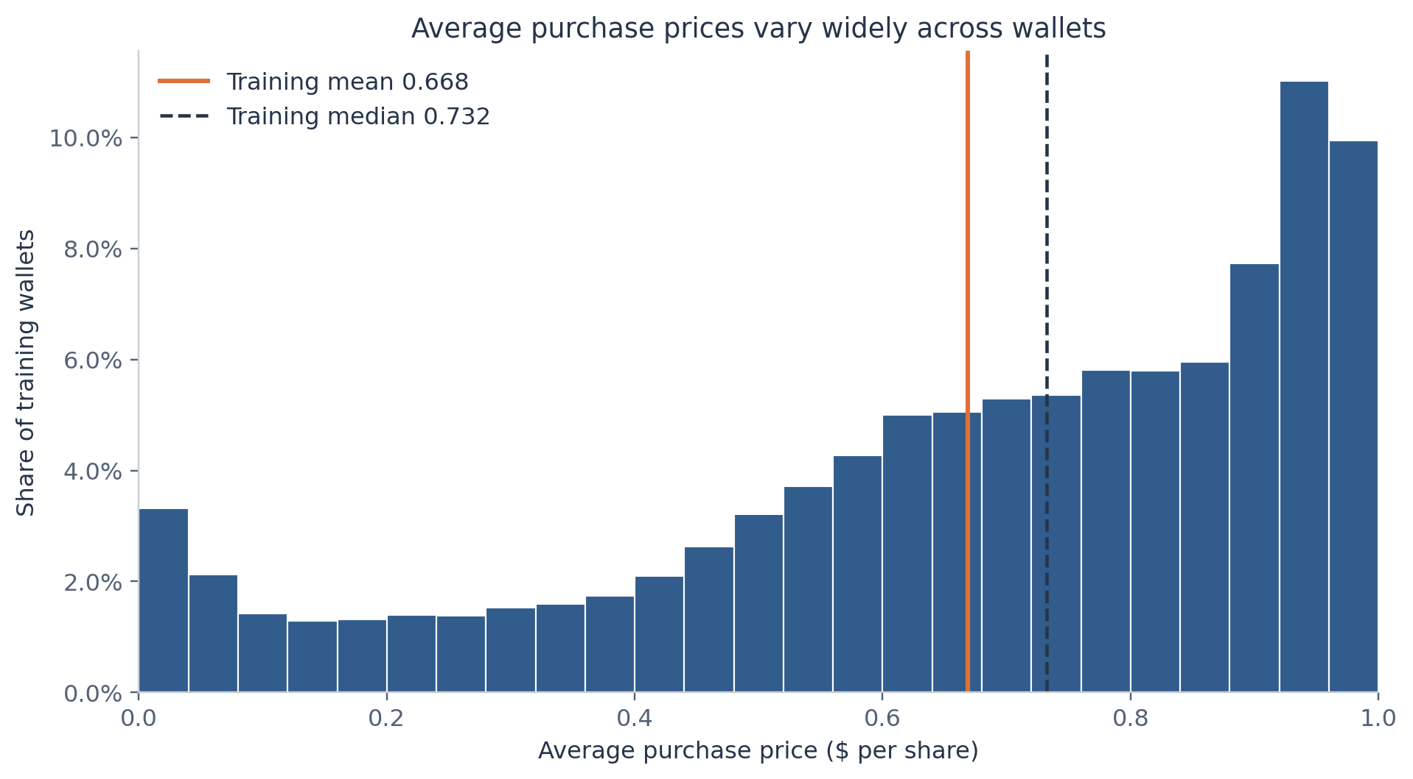
Question and data
WALLET · JIAHONG
How well do six wallet traits predict a wallet’s average purchase price?
Does gradient boosting beat linear regression?
55,952 wallets, one row each. Target: volume-weighted price paid for shares bought.
Reminder: “An informed trader is one who beats the price, not one who wins a lot.”
Wallet part · Slide 1 of 4
Notes:
JIAHONG. Our question is how well wallet trading characteristics predict average purchase price, and whether gradient boosting improves on linear regression. The dataset has 55,952 wallets, one row per wallet. The target is the volume-weighted price of the shares each wallet bought. The histogram shows training wallets. We keep all wallets and exclude the confirmed flag. This cohort comes from five selected event groups, so we describe the wallets in this dataset. A higher or lower purchase price does not by itself tell us whether the wallet made a profit.

Slide 12
Approach
WALLET · JIAHONG
Split
Models
Inputs
44,761 training wallets and 11,191 test wallets. One fixed random split; every method sees the same test wallets.
Mean baseline, additive linear regression, and histogram gradient boosting for nonlinear patterns and interactions.
Trade count, market count, activity span, concentration, total spending, largest purchase. Skewed inputs use log(1 + x).
Five-fold validation happens inside training only. Boosting is chosen from a six-setting grid by validation error; the test set stays untouched.
Data Partitioning
Models Evaluated
44,761 training wallets and 11,191 held-out testing wallets.
Mean Baseline vs. Additive Linear Regression vs. HistGradientBoosting.
Input Feature Matrix (Log-Transformed)
Trade Count
Market Count
Activity Span
Concentration
Total Outlay
Max Single Purchase
Wallet part · Slide 2 of 4
Notes:
JIAHONG. We reserve twenty percent of wallets for final evaluation with one fixed random split: 44,761 training wallets and 11,191 test wallets. Every method gets exactly the same test wallets. Five-fold validation happens entirely inside training. We compare a mean baseline, an additive linear regression, and histogram gradient boosting, which can capture nonlinear patterns and interactions. The inputs are trade count, market count, activity span, concentration, total spending and largest purchase; five skewed predictors use log of one plus the value. We choose boosting settings from a small six-configuration grid using validation error, and the test set stays outside model selection.

Slide 13
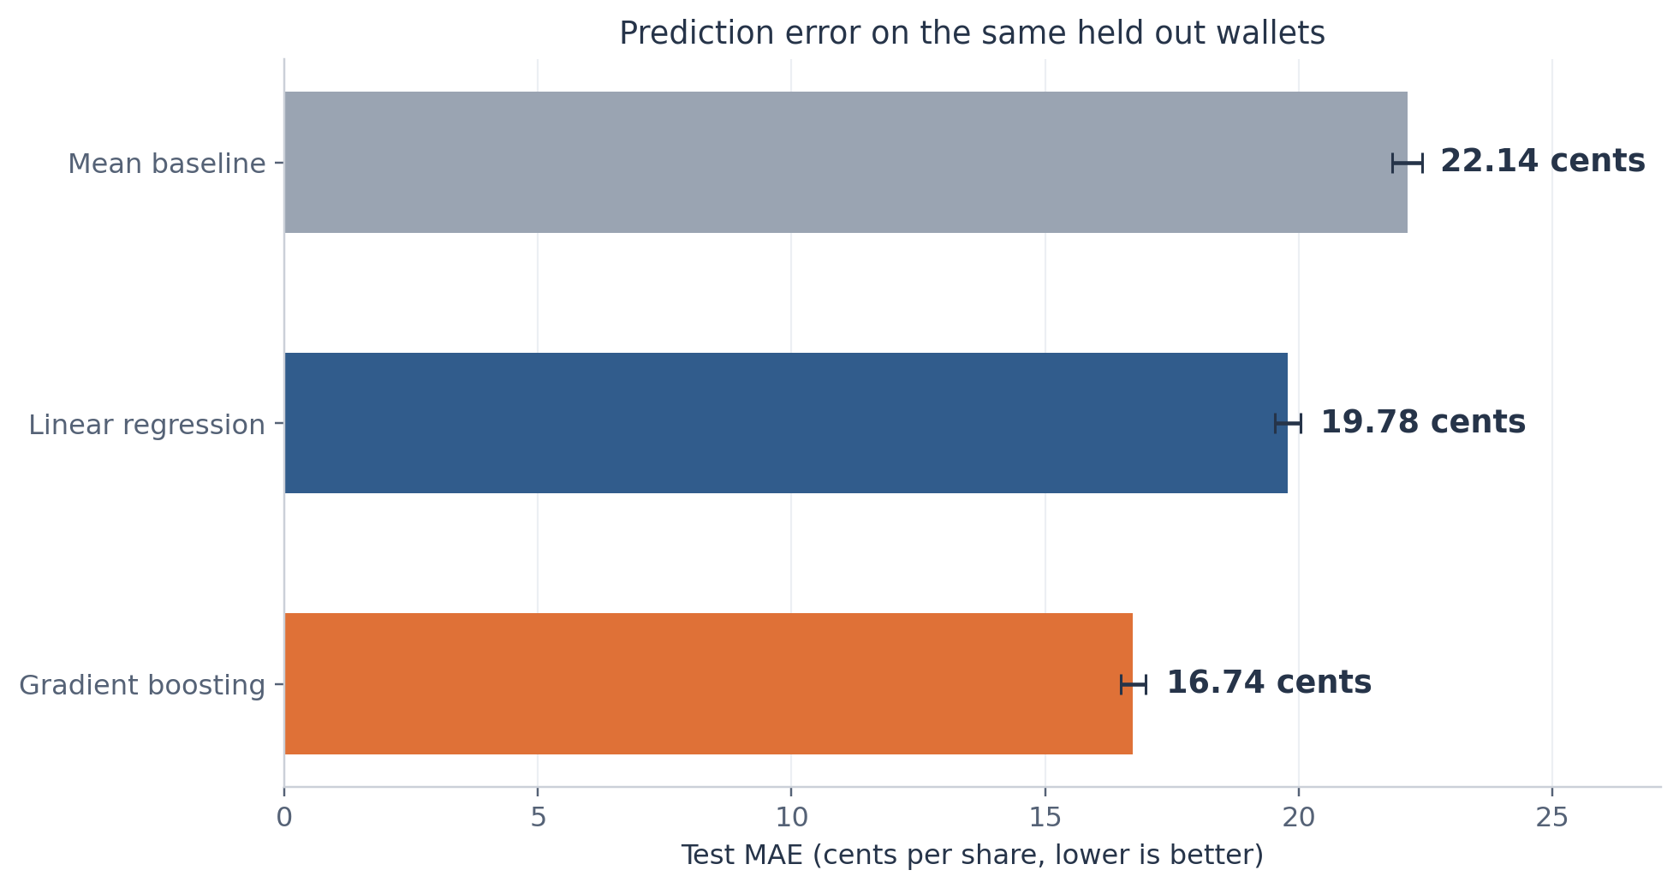
Results
WALLET · JIAHONG
22.14¢
mean baseline, test MAE
19.78¢
linear regression
16.74¢
gradient boosting
Boosting beats linear by 3.04¢ (95% interval 2.86 to 3.23¢), a 15.4% improvement. R²: 0.368 vs 0.197.
Wallet part · Slide 3 of 4
Notes:
JIAHONG. On the held-out wallets, the mean baseline has an average absolute error of 22.14 cents per share. Linear regression reduces this to 19.78 cents, and gradient boosting reduces it further to 16.74 cents. That is a 15.4 percent improvement over linear regression: an absolute difference of 3.04 cents, with a paired wallet-bootstrap interval from 2.86 to 3.23 cents. Boosting also has a higher R squared, about 0.368 compared with 0.197. The comparison is consistent across MAE, RMSE and R squared. The intervals assume independent wallets, which may be imperfect because wallets can trade in common markets.

Slide 14
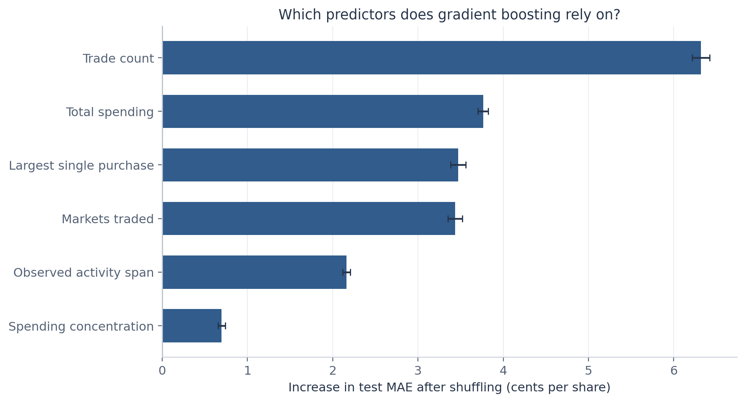
Interpretation
WALLET · JIAHONG
Trade count matters most: shuffling it raises test error by about 6.32¢.
+6.32¢ MAE Impact
Removing spending and largest purchase raises boosting error from 16.74¢ to 19.97¢.
This is descriptive: not profit, trading skill or cause.
Total Spending & Max Purchase
High Importance
Scope Limitation Note
Secondary indicators driving trading profile separation.
This model captures behavioral archetypes (longshot bias vs. favorite buyers) rather than serving as a direct causal indicator of net profitability or trading skill.
Wallet part · Slide 4 of 4
Notes:
JIAHONG. To interpret the flexible model, we shuffle one predictor at a time and measure the increase in test error. Trade count produces the largest increase, about 6.32 cents. Spending, largest purchase and number of markets also contribute. This measures how much the fitted model relies on an input, not whether the input raises or lowers price, and correlated predictors complicate attribution. Removing spending and largest purchase increases boosting error from 16.74 to 19.97 cents, so the monetary summaries add information. We cannot infer profit, trading skill, future forecasting accuracy or causal effects from this table.

Slide 15
UCLA STATS C161 / C261 · MIDTERM PRESENTATION
Thank You!
Questions & Comments?
We welcome feedback on our calibration methodology and wallet profiling pipeline.
Q&A Session (~3 mins)
Leo Wong
Aaron Wen
Jiahong Chen
Literature & Deck
Market Calibration
Wallet Analysis

Slide 16
Details if asked
BACKUP · FOR Q&A
Train and test
Mid-range prices
Slopes by category
Train: 841 events, 3,215 markets, all closed before Sep 1. Test: 860 events, 3,511 markets. An event that straddles Sep 1 goes wholly to test.
Only prices from 5¢ to 95¢: test Brier at 24h is 0.148 for the market and 0.150 for both models.
At 24h: Politics 1.03, Technology 1.11, Entertainment 1.12, Economy 0.92. Only Entertainment’s interval sits just above 1 (1.00 to 1.29).
Backup
Notes:
BACKUP. B1: no event is on both sides of the train/test split. B2: the near-certain markets are not what makes the market look good; neither model beats it on 5 to 95 cent prices either. B3: with four categories tested, one borderline interval is not unusual by chance. Other likely questions: why trade prices instead of the order book (the book only covered about 22% of markets; correlation 0.92 where both exist); why resample by event (markets in one event are dependent); why Brier score and not accuracy (it is a proper scoring rule, accuracy treats 51% and 99% as the same call).

